Slide 1



"Banking Management with SQL"
Banking Management with SQL
Project by Venkata Ranga Chinta

Slide 2

Introduction
A Banking Management System efficiently handles customer accounts, transactions, loans, and credit card details using SQL.
It ensures secure data storage, quick retrieval, and seamless banking operations through structured queries.
Key Features
Customer Management – Store and manage customer details efficiently.
Account Management – Track different types of accounts with balances.
Transaction Processing – Record deposits, withdrawals, and transfers.
Loan Management – Maintain loan details, interest rates, and statuses.
Credit Card Management – Handle credit limits, expiry dates, and statuses.
Data Security & Integrity – Ensure unique records and prevent inconsistencies.
Real-time Queries – Retrieve customer, account, and transaction details instantly.
Risk Analysis – Identify inactive accounts, high-risk credit cards, and loan statuses.

Slide 3



Tables in my Database
Customers_tb – Stores customer details (Customer_ID, Name, Email, Phone Number, City, Date of Birth).
Accounts_tb – Maintains account information (Account_ID, Customer_ID, Account Type, Balance, Open Date, Status1).
Transactions_tb – Records all transactions (Transaction_ID, Account_ID, Transaction Type, Amount, Transaction Date, Mode).
Loans_tb – Tracks loans taken by customers (Loan_ID, Customer_ID, Loan Type, Loan Amount, Interest Rate, Tenure, Status2).
CreditCard_tb – Manages credit card details (Card_ID, Customer_ID, Card Type, Credit Limit, Expiry Date, CVV, Status3).

Slide 4

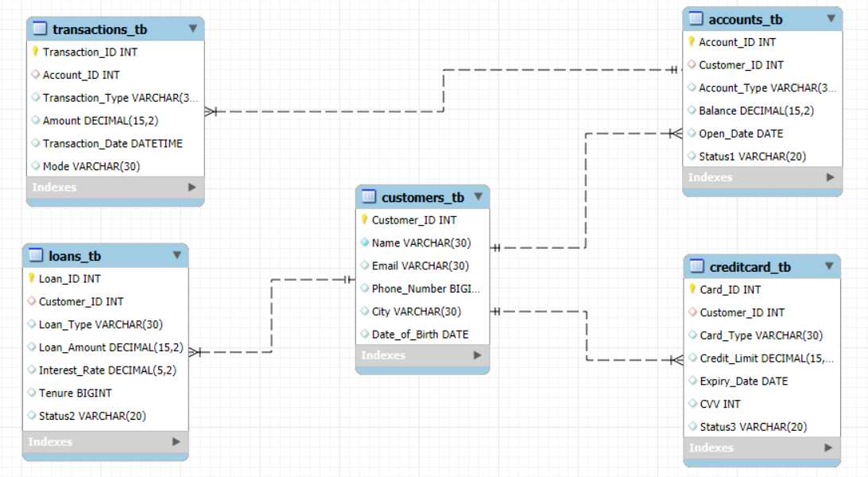

ER Diagram

Slide 5


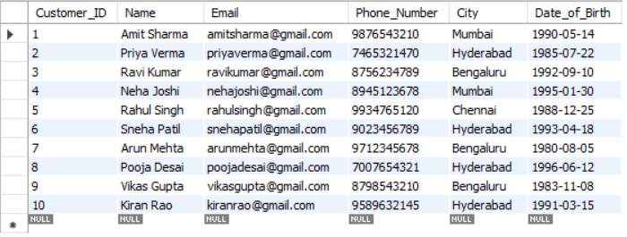
Creating Database
Creating Tables & Inserting Records
create database SQL_Project;
use SQL_Project;
1. Customers Table
CREATE TABLE Customers_tb (Customer_ID INT PRIMARY KEY, Name VARCHAR(30) NOT NULL,Email VARCHAR(30) UNIQUE, Phone_Number bigint,City varchar(30),Date_of_Birth DATE);
select * from Customers_tb;

Slide 6

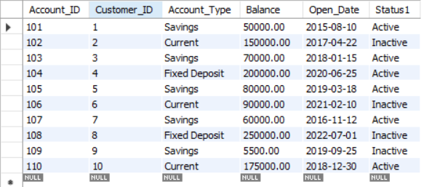
Creating Tables & Inserting Records
2. Accounts Table
CREATE TABLE Accounts_tb (Account_ID INT PRIMARY KEY,Customer_ID INT,Account_Type VARCHAR(30),Balance DECIMAL(15,2), Open_Date DATE,Status1 VARCHAR(20),FOREIGN KEY (Customer_ID) REFERENCES Customers_tb(Customer_ID));
select * from Accounts_tb;

Slide 7

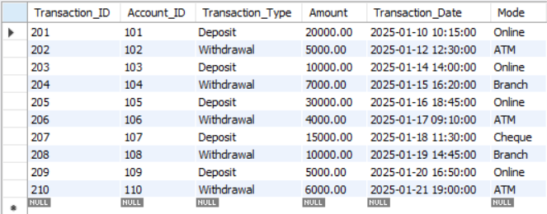
Creating Tables & Inserting Records
3. Transactions Table
CREATE TABLE Transactions_tb (Transaction_ID INT PRIMARY KEY,Account_ID INT,Transaction_Type VARCHAR(30),Amount DECIMAL(15,2), Transaction_Date DATETIME DEFAULT CURRENT_TIMESTAMP,Mode VARCHAR(30),FOREIGN KEY (Account_ID) REFERENCES Accounts_tb(Account_ID));
select * from Transactions_tb ;

Slide 8

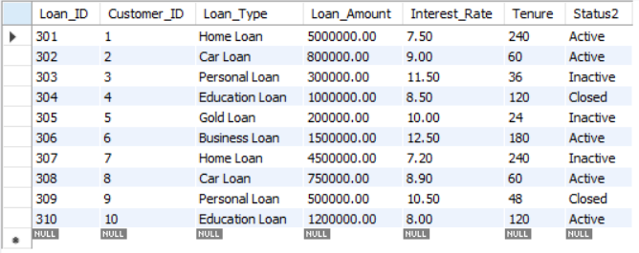
Creating Tables & Inserting Records
4. Loans Table
CREATE TABLE Loans_tb (Loan_ID INT PRIMARY KEY,Customer_ID INT,Loan_Type VARCHAR(30),Loan_Amount DECIMAL(15,2), Interest_Rate DECIMAL(5,2),Tenure BIGINT,Status2 VARCHAR(20),FOREIGN KEY (Customer_ID) REFERENCES Customers_tb(Customer_ID));
select * from Loans_tb ;

Slide 9

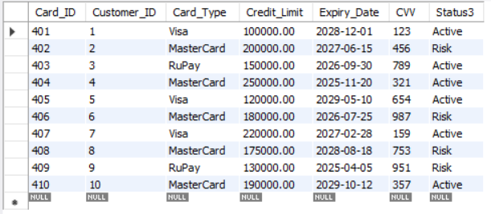
Creating Tables & Inserting Records
5. Credit Card Table
CREATE TABLE CreditCard_tb (Card_ID INT PRIMARY KEY,Customer_ID INT,Card_Type VARCHAR(30),Credit_Limit DECIMAL(15,2), Expiry_Date DATE,CVV INT,Status3 VARCHAR(20),FOREIGN KEY (Customer_ID) REFERENCES Customers_tb(Customer_ID));
select * from CreditCard_tb ;

Slide 10

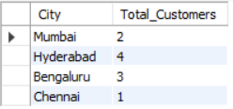

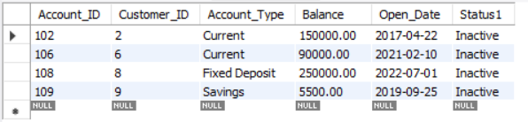
1. Count the number of customers from each city
SELECT City, COUNT(*) AS Total_Customers FROM Customers_tb GROUP BY City;
2. Find all inactive accounts
SELECT * FROM Accounts_tb WHERE Status1 = ‘Inactive';

Slide 11

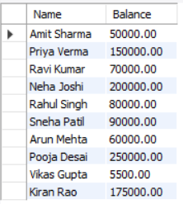
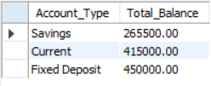
3. Find the customers names and their account balance
SELECT c.Name, a.Balance
FROM Customers_tb c
JOIN Accounts_tb a ON c.Customer_ID = a.Customer_ID;
4. Find total balance per account type
SELECT Account_Type, SUM(Balance) AS Total_Balance FROM Accounts_tb GROUP BY Account_Type;

Slide 12

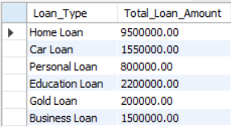

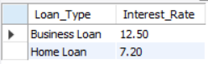
5. Find total loan amount per loan type
SELECT Loan_Type, SUM(Loan_Amount) AS Total_Loan_Amount
FROM Loans_tb GROUP BY Loan_Type;
6. Find the highest and lowest interest rates on loans
SELECT Loan_Type, Interest_Rate
FROM Loans_tb
WHERE Interest_Rate = (SELECT MAX(Interest_Rate) FROM Loans_tb)
OR Interest_Rate = (SELECT MIN(Interest_Rate) FROM Loans_tb);

Slide 13

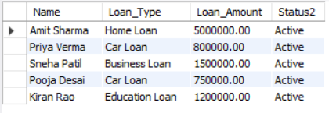
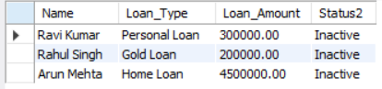

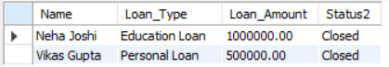
7. Find customers with active loans and their names
SELECT c.Name, l.Loan_Type, l.Loan_Amount, l.Status2
FROM Customers_tb c
JOIN Loans_tb l ON c.Customer_ID = l.Customer_ID
WHERE l.Status2 = 'Active';
8. Find customers with inactive loans and their names
SELECT c.Name, l.Loan_Type, l.Loan_Amount, l.Status2
FROM Customers_tb c
JOIN Loans_tb l ON c.Customer_ID = l.Customer_ID
WHERE l.Status2 = ‘Inactive';
9. Find customers with closed loans and their names
SELECT c.Name, l.Loan_Type, l.Loan_Amount, l.Status2
FROM Customers_tb c
JOIN Loans_tb l ON c.Customer_ID = l.Customer_ID
WHERE l.Status2 = ‘Closed';

Slide 14

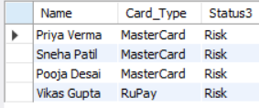

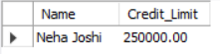
10. Find all customers with 'Risk' status credit cards
SELECT c.Name, cc.Card_Type, cc.Status3
FROM Customers_tb c
JOIN CreditCard_tb cc ON c.Customer_ID = cc.Customer_ID
WHERE cc.Status3 = 'Risk';
11. Find the customer with the highest credit limit
SELECT c.Name, cc.Credit_Limit
FROM Customers_tb c
JOIN CreditCard_tb cc ON c.Customer_ID = cc.Customer_ID
ORDER BY cc.Credit_Limit DESC LIMIT 1;

Slide 15
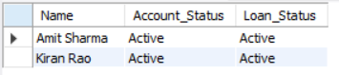

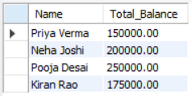
12. Find customers who have both an active loan and an active account
SELECT c.Name, a.Status1 AS Account_Status, l.Status2 AS Loan_Status
FROM Customers_tb c
JOIN Accounts_tb a ON c.Customer_ID = a.Customer_ID
JOIN Loans_tb l ON c.Customer_ID = l.Customer_ID
WHERE a.Status1 = 'Active' AND l.Status2 = 'Active';
13. Find customers with total account balance greater than ₹1,00,000
SELECT c.Name, SUM(a.Balance) AS Total_Balance
FROM Customers_tb c
JOIN Accounts_tb a ON c.Customer_ID = a.Customer_ID
GROUP BY c.Name
HAVING Total_Balance > 100000;

Slide 16

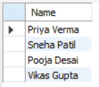

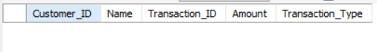
14. Find high-risk customers (with ‘Risk’ credit cards and inactive accounts)
SELECT c.Name
FROM Customers_tb c
JOIN CreditCard_tb cc ON c.Customer_ID = cc.Customer_ID
JOIN Accounts_tb a ON c.Customer_ID = a.Customer_ID
WHERE cc.Status3 = 'Risk' AND a.Status1 = 'Inactive';
15. Find customers who made transactions above ₹50,000
SELECT c.Customer_ID, c.Name, t.Transaction_ID, t.Amount, t.Transaction_Type
FROM Customers_tb c
JOIN Accounts_tb a ON c.Customer_ID = a.Customer_ID
JOIN Transactions_tb t ON a.Account_ID = t.Account_ID
WHERE t.Amount > 50000;

Slide 17


Summary
This project implements a Banking Management System using SQL to efficiently store, manage, and retrieve customer financial data. The system includes multiple interconnected tables for customers, accounts, transactions, loans, and credit cards.
Key Highlights:
✔ Structured Database – Designed relational tables with primary & foreign keys for data integrity. ✔ Data Management – Stores customer details, account balances, transactions, and loan records. ✔ SQL Queries – Used JOINs, GROUP BY, HAVING, ORDER BY, and subqueries to analyze banking data. ✔ Financial Insights – Identified high-value transactions, risk factors, and customer activity. ✔ Optimized Performance – Implemented constraints (UNIQUE, NOT NULL) for data accuracy.

Slide 18





Thank you!
"Appreciate Your Time! Looking Forward to Feedback."
Project by enkata anga hinta

